Slide 1
Risk analysis of SPY and sector ETFs in machine learning
Week 6 Presentation
Advisor: Khaldoun khashanah
PREPARED BY
Tan Tu Siyuan Liu
Zihao Gao

Slide 2
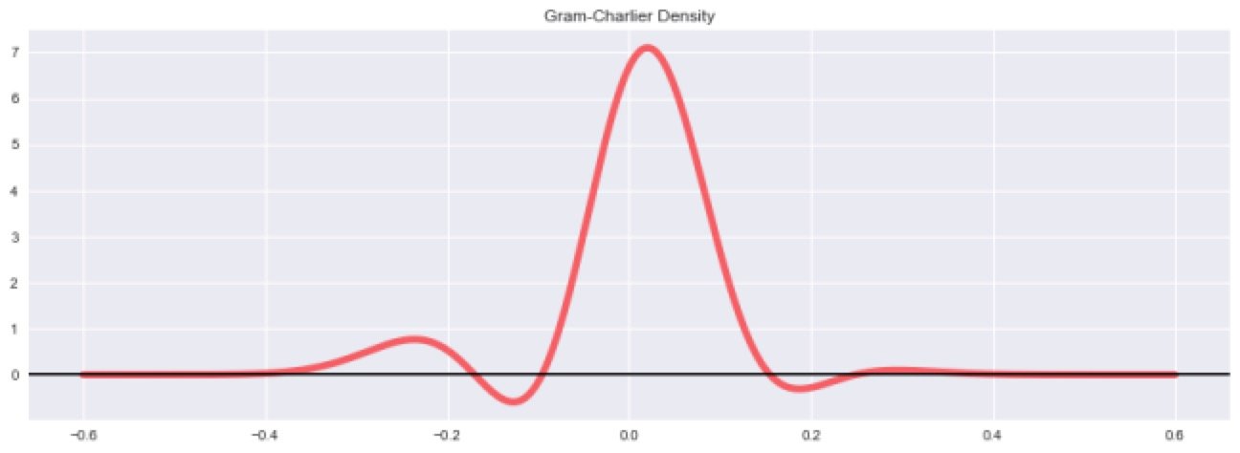
Original Gram-Charlier Density

Slide 3
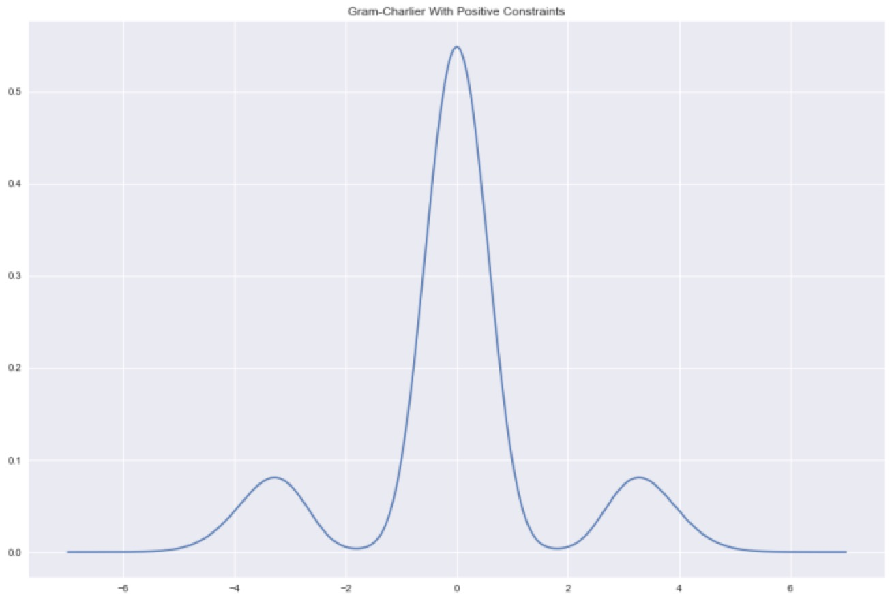
Transformed Gram-Charlier Density

Slide 4
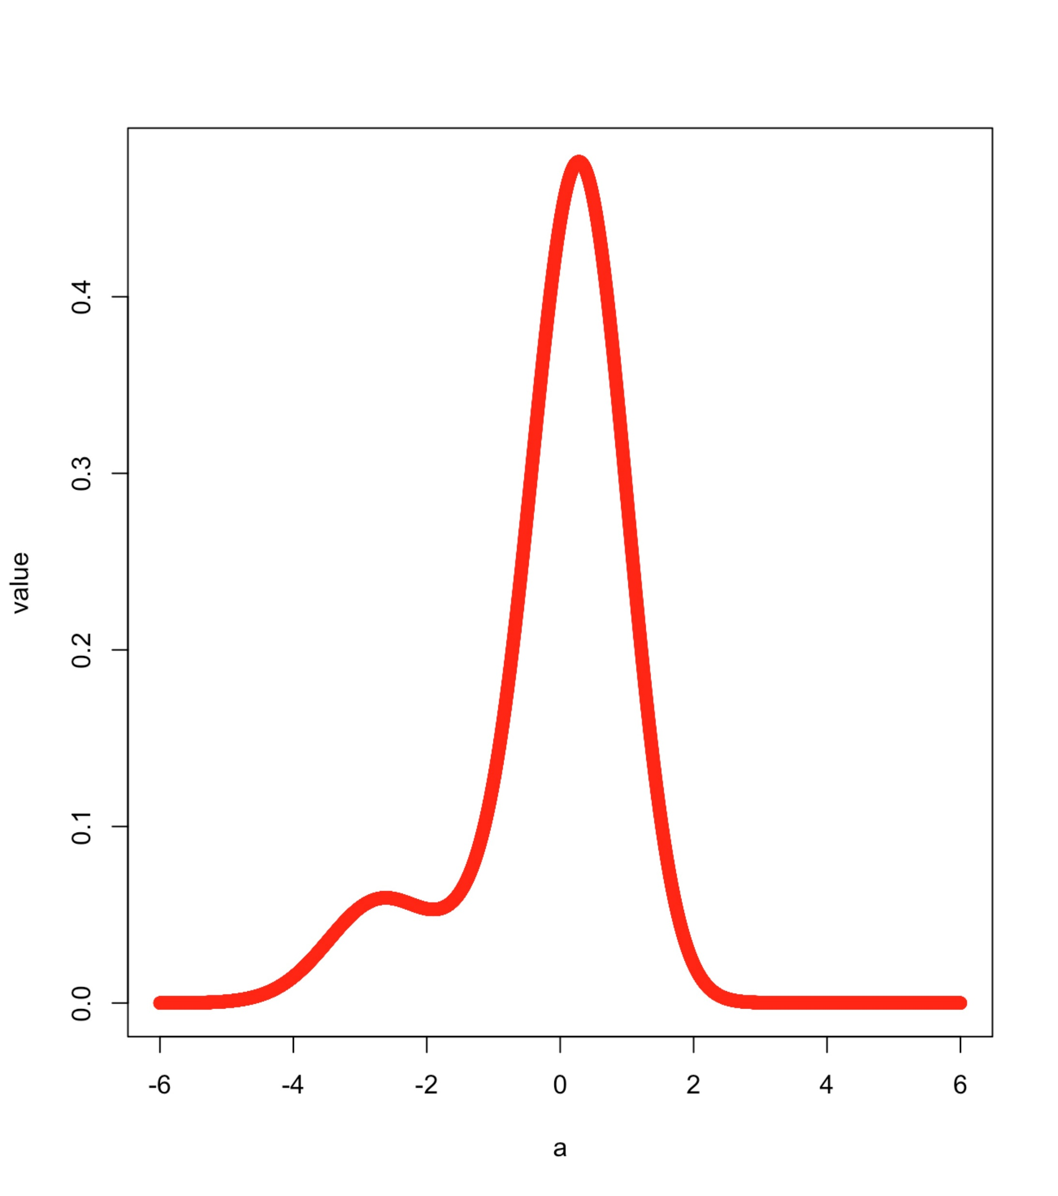
Imporved with MLE

Slide 5
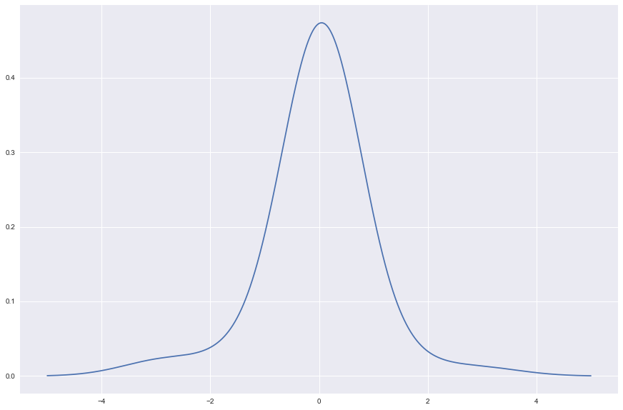
Sample Of Real data PDF Plot

Slide 6
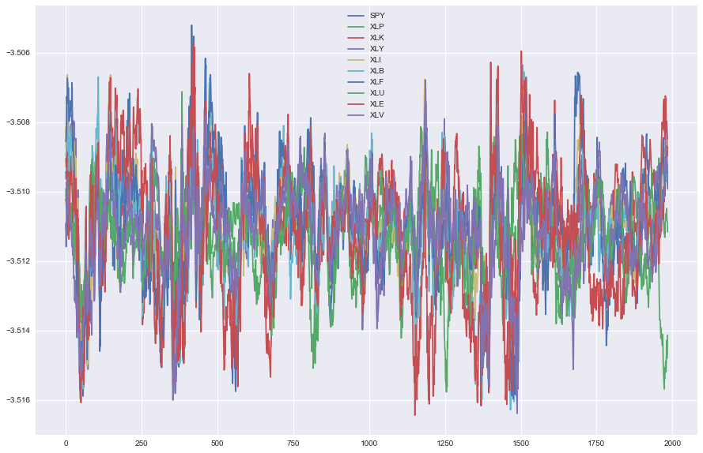
30 Day VaR Result

Slide 7
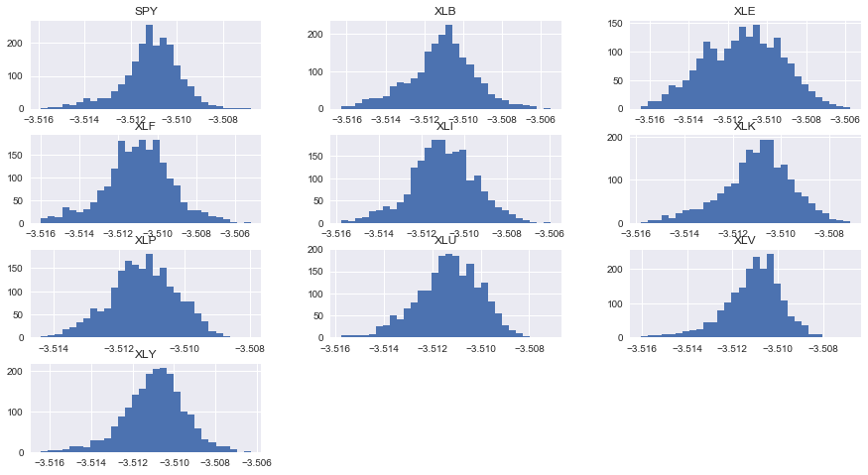
30 Day VaR Result

Slide 8
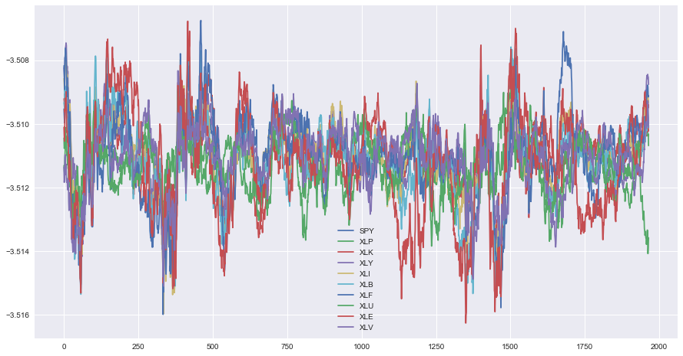
50 Day VaR result

Slide 9
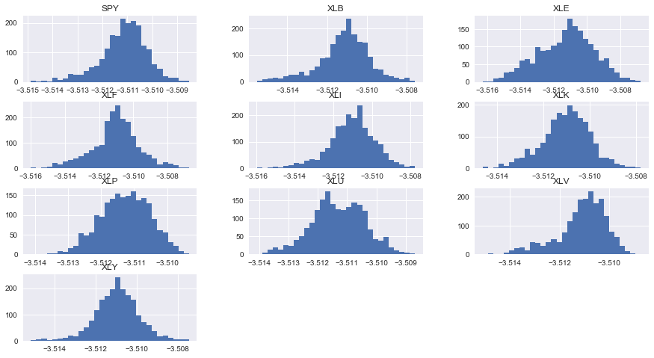
50 Day Var Result

Slide 10
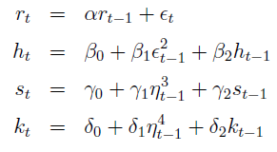
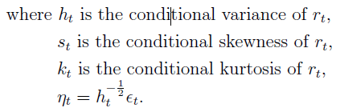
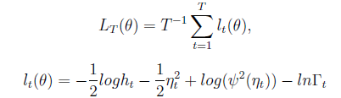
AR-GARCH-Gram-Charlier
Rt is log return and we will use AR(1) model for it.
We can proof that and Rt have the same conditional Skewness and Kurtosis.
Then we can use AR(1) and GARCH(1,1) to get all the parameters by using Maximum Likelihood Estimation especially St and Kt.
Once we get St and Kt, we get our GC Density.

Slide 11
Thank you

